Slide 1


Life Expectancy Improvement Project
Team Members:
Fawad Khan
Divya Thailam
Reshma Madhuri
Pravalika Vulimiri
Naga Adithya Kaushik Chandrabhatla

Slide 2
CONCEPTS
RESEARCH OBJECTIVE(S)
RESEARCH QUESTIONS & HYPOTHESIS
LITERATURE REVIEW
RESEARCH METHODS
DATA ANALYSIS
RESEARCH DISCUSSION
CONCLUSION
RESEARCH SUMMARY
RESEARCH LIMITATIONS

Slide 3

RESEARCH OBJECTIVE(S)
Issues:
Healthcare access, Quality of health, GDP, Socioeconomic conditions.
Objectives:
Improving access to Healthcare.
Promoting Healthy Life.
Ensure economic growth is inclusive

Slide 4

RESEARCH QUESTIONS & HYPOTHESIS
Research Question
What are the factors that impact life expectancy in Asia?
Hypothesis
Access to healthcare, lifestyle factors, and socioeconomic status all significantly impact life expectancy in Asia, and the relative importance of these factors varies across different countries and regions within the continent.

Slide 5
LITERATURE REVIEW
On life expectancy in Singapore, Malaysia, and Thailand, the authors want to investigate the effects of demographic shifts, socioeconomic disparity, and the availability of healthcare resources.
From 1980 to 2008, this cross-country study gathered yearly data from three Southeast Asian nations. The dependent variable is life expectancy, and the three key factors are demography, socioeconomic position, and access to health care. The results of a structural equation model demonstrate that higher levels of socioeconomic advantages and the availability of more healthcare resources are more likely to increase life expectancy. Contrarily, demographic changes have a higher likelihood of raising it through the resources for health care.
The authors propose that greater efforts should be made to broaden and enhance the coverage of healthcare programs in order to reduce regional variations in the use of healthcare and enhance the general health of people in these three Southeast Asian nations.

Slide 6

Literature Review

Slide 7
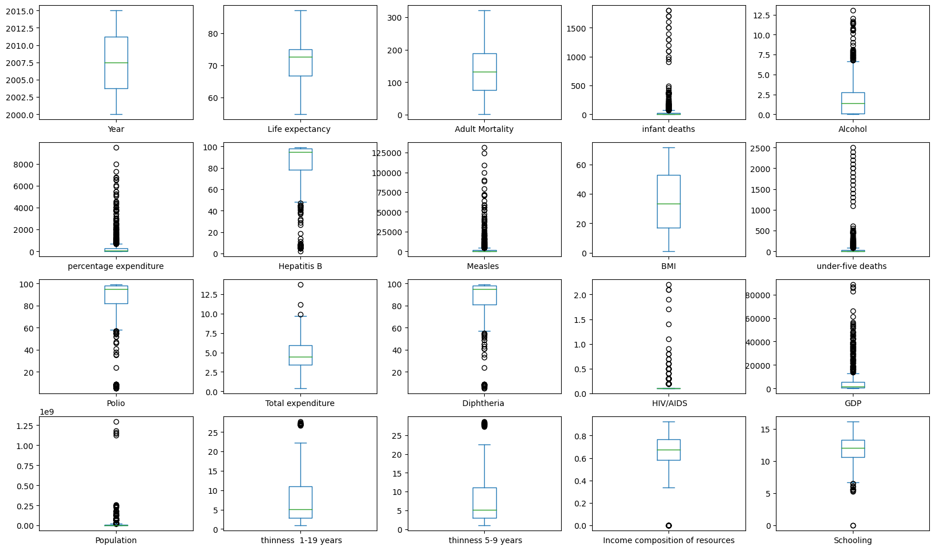
EXPLORATORY ANALYSIS
Since there are many outliers, the data is very skewed, to reduce the skewness. We applied standard scalar to the data to standardize it.

Slide 8
RESEARCH METHODS:
Quantitative
Linear Regression
Hypothesis Testing
Random Forest Regressor
SVR
XGBoost

Slide 9
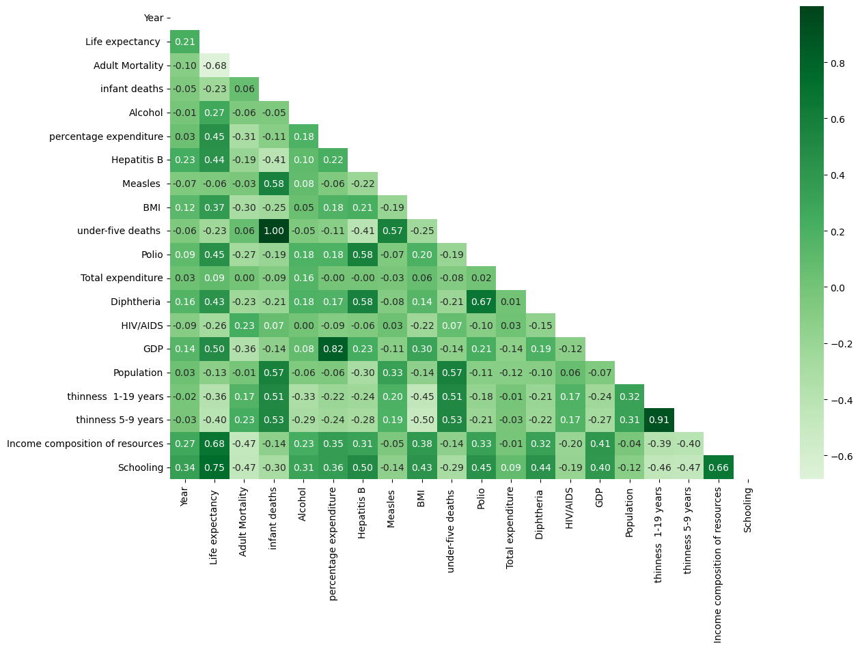
DATA ANALYSIS

Slide 10
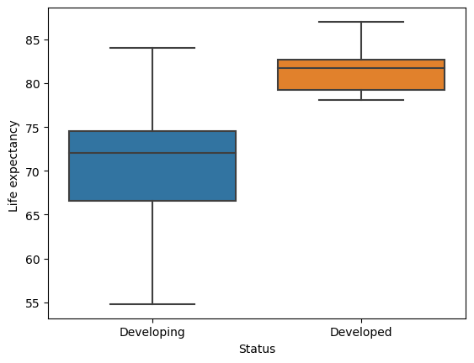

Slide 11
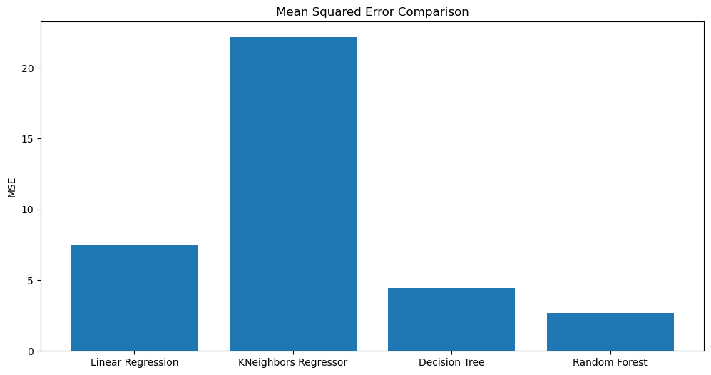

Slide 12
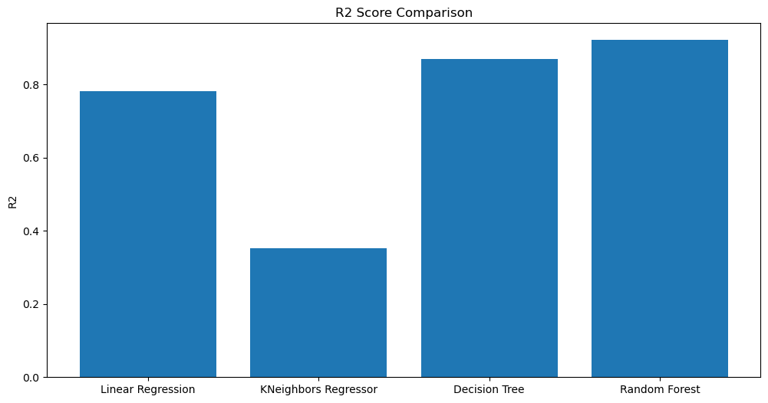

Slide 13
RESEARCH DISCUSSION

Slide 14
CONCLUSION
RESEARCH SUMMARY
RESEARCH LIMITATIONS

Slide 15
RESEARCH SUMMARY

Slide 16
RESEARCH LIMITATIONS

Slide 17
Research Methods Performance
Linear Regression: R² score of 0.82, mean squared error of 17.34
Decision Tree: R² score of 0.91, mean squared error of 9.71
Random Forest: R² score of 0.95, mean squared error of 6.29
KNN: R² score of 0.79, mean squared error of 20.21

Slide 18
SUMMARY STATISTICS
The average life expectancy across all countries is 71.19 years, with a standard deviation of 5.78 years.
Adult mortality has an average of 133.64 deaths per 1,000 population and a standard deviation of 77.52 deaths.
The average number of infant deaths is 63.46, with a standard deviation of 217.35 deaths.
Alcohol consumption per capita has an average of 1.99 liters, with a standard deviation of 2.41 liters.
The average percentage expenditure on health is 493.97, with a standard deviation of 1169.13.

Slide 19
Hepatitis B immunization coverage has an average of 84.11%, with a standard deviation of 21.98%.
The average number of measles cases is 4442.91, with a standard deviation of 13958.12 cases.
The average Body Mass Index (BMI) is 19.43, with a standard deviation of 4.51.
The average under-five deaths is 85.59, with a standard deviation of 21.22 deaths.
Polio immunization coverage has an average of 86.19%, with a standard deviation of 19.46%.

